Slide 1
Iowa Park High School Dual Credit Program
Students at IPHS have the opportunity to earn 36 college credit hours through our partnership with Vernon College. Courses are taught by teachers on our campus, through online classes, or via distance learning. These credits transfer to any public college or university in Texas.
Total Credit Hours Earned
Class of 2012-2013 | 999 Hours
Class of 2013-2014 | 1074 Hours
The average cost per course at Vernon College is $430.00.
Vernon College currently doubles any contributions.
$1000=$3000
Courses Offered
Composition I | Composition II
British Literature I | British Literature II
U.S. History I | U. S. History II
US Government | Economics
Intro. to Computing | Texas Government
College Algebra | College Trigonometry
28 current seniors have been invited to become members of the Phi Theta Kappa Honor Society.
Students must maintain a 3.5 GPA through 12 hours of coursework to be eligible for this honor society.

Slide 2
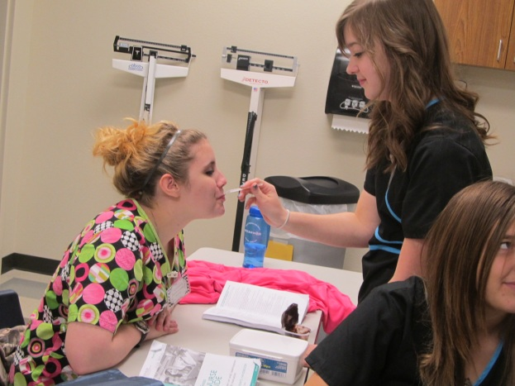
Iowa Park High School Other Programs with Vernon College
Health Sciences Program
CNA | 24 Students
LVN | 12 Students
CNA State Assessment Passing Rate | 100%
CNA students gaining clinical hours at our local nursing home. 5 of our LVN students hold jobs at assisted living centers in Wichita Falls and are making between $9.00-$10.00/hour. The CNA class is projected to be full again for the 2014-2015 school year. All classes are free to students
Welding Program
Junior Year | Senior Year
Fall Shielded Metal Arc Physical Hazards | Fall Intro. to Computing Gas Tungsten Arc
Spring Blueprint Reading Gas Metal Arc | Spring Intro. to Pipe
Currently 10 students enrolled Funded through a grant from TEA Updated welding equipment All classes are free to students

